Slide 1
CDS Requirements for MVP
Treater: i.e., Psychiatrist, Psychotherapist, (Group Leader needs are not being consider in first round)
Treater: i.e., Psychiatrist, Psychotherapist, (Group Leader needs are not being consider in first round)

Slide 2
Session Preparation (before the patient and provider are in the treatment room):
1- As a Treater have ability to review today’s/history Patient PHQ score
Patient Name
Patient identifying info
Clinician associated with PHQ
Today’s PHQ date, PHQ completion status
Alerts
2- As a Treater have become aware of ‘red flags’/details (including action) associated with PHQ suicide item score
3- As a Treater have become aware of ‘red flags’ / (details (including action) associated with treatment progress
4- As a Treater have ability to review today’s/history other medically relevant information to treat the patient for depresseion

Slide 3
During Session (patient and provider are in the treatment room):
1- As a Treater have ability to review today’s/history Patient PHQ score
Patient Name
Patient identifying info
Clinician associated with PHQ
Today’s PHQ date, completion time, progress, status
Alerts
2- As a Treater have ability to review today’s/history Patient PHQ item scores
3- As a Treater have become aware of ‘red flags’/details (including action) associated with PHQ suicide item score
4- As a Treater have become aware of ‘red flags’ / (details (including action) associated with treatment progress

Slide 4
After the Session (match the treater’s process for documenting the session i.e., some treaters document during the session, some treaters document after the session):
1- Document 3 Essential Questions (structured data)
Today’s PHQ score + each item
What was the focus of today’s session
Psychotherapy Intervention provided
2- What other information is sought?
Episode of care initiation date
Current session number out of y planned episodes of care

Slide 5
The following slides present various visualizations Janey has seen during the course of the last 2 weeks. Use the visualizations to identify the data fields we want to include in the first release ie those needed to inform decision making for a one-on-one therapy session, aimed at treating major depression.

Slide 6
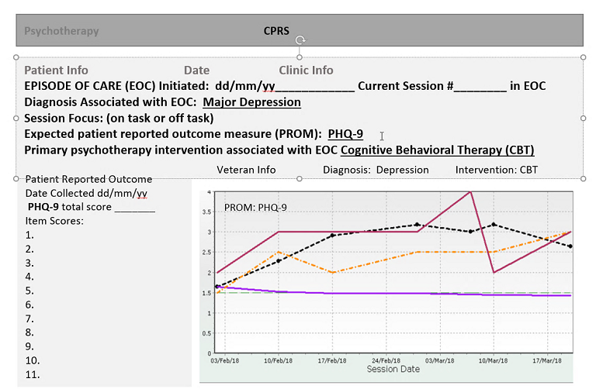
Legend
Dashed line indicates acceptable/not acceptable score

Slide 7
<Current Intervention>:
Screen Title
Actionable Recommendations
Recommendations to move treaters inline with Evidence Based Practice
Recommendations specific to treaters who already practice Evidence Based Psychotherapy
Patient Information
Patient Name
Other fields CPRS includes in the patient banner
Mental Health Factors
Primary MH Diagnosis
Other Diagnoses
Current Intervention
Episode x of y
Intervention History
Medications
Labs associated with MH Meds?
Related Information
Other Specific Labs
Graph of PHQ scores over time with indication of cutoff or guard rails or acceptable range
Score
Legend
Time
Graph features:
Adjust Time
Toggle graph / table
Overlay past, current and future sessions
Overlay past, current and future medications
When available include predictive lines indication current path vs different intervention path

Slide 8
Dashed lines indicate goal range based on pt/therapist goals
PHQ Score
Legend
Time

Slide 9
In Nashville someone mentioned therapists described wanting to see PHQ scores in a Stacked Bar Graph. I’m not sure what that would be? Stacked Bar Graphs are typically used for frequency distribution. Can someone provide an example of what the therapists were looking for?
Label
Legend
Label

